Slide 1
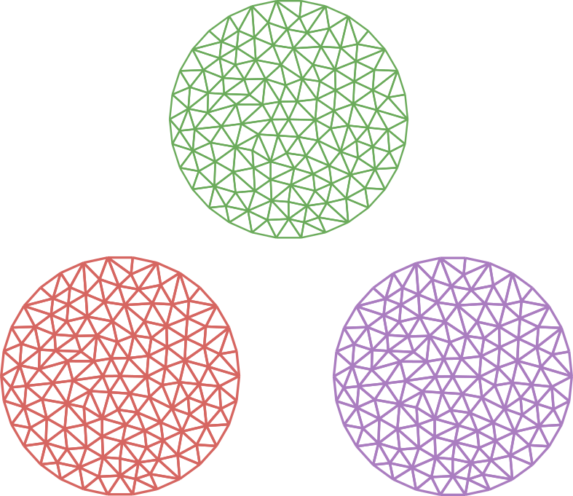


FEM in Julia
An overview of the package
landscape for FEM in Julia
Kristoffer Carlsson
Division of Material and Computational Mechanics
Chalmers University of Technology
@KristofferC
kristoffer.carlsson@chalmers.se
Notes:
Kristoffer Carlsson
Material and computational mechanics division from Chalmers University of Technology,
Gothenburg, on the South West coast.
Tradition for new talkers at JuliaCon to say how they got started with Julia
For me, interactivity combined with performance, like to poke around in a REPL
Started writing some FEM code in pure Python, very slow, messing around with Cython and JIT annotations.
Tried Julia, blown away by performance and open source -> look under hood
TODO: generate images for RVE

Slide 2
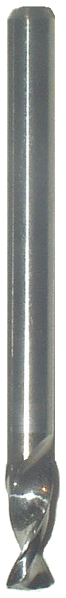
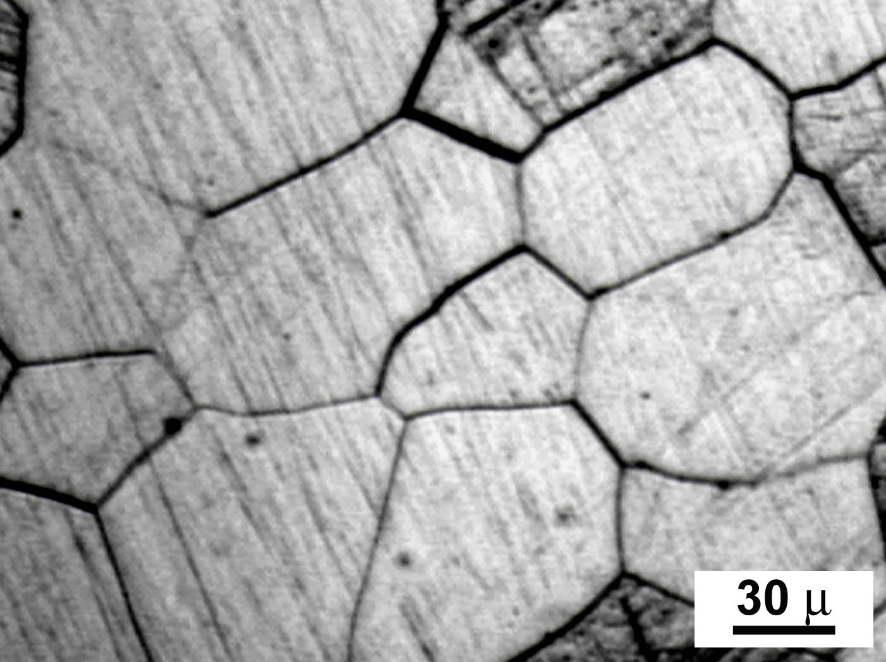
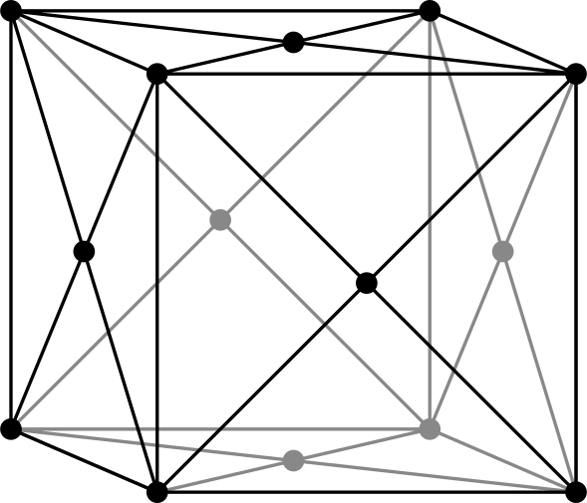
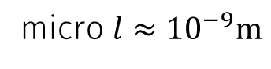
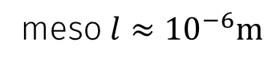
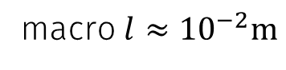
Motivation
macro$l≈{10}^{−2}m$
meso$l≈{10}^{−6}m$
micro $l≈{10}^{−9}m$
Macroscopic homogeneous response is a volume average of heterogenities on a smaller scale
Material models on macroscopic scale cannot predict new response to changes on the smaller scale

Slide 3
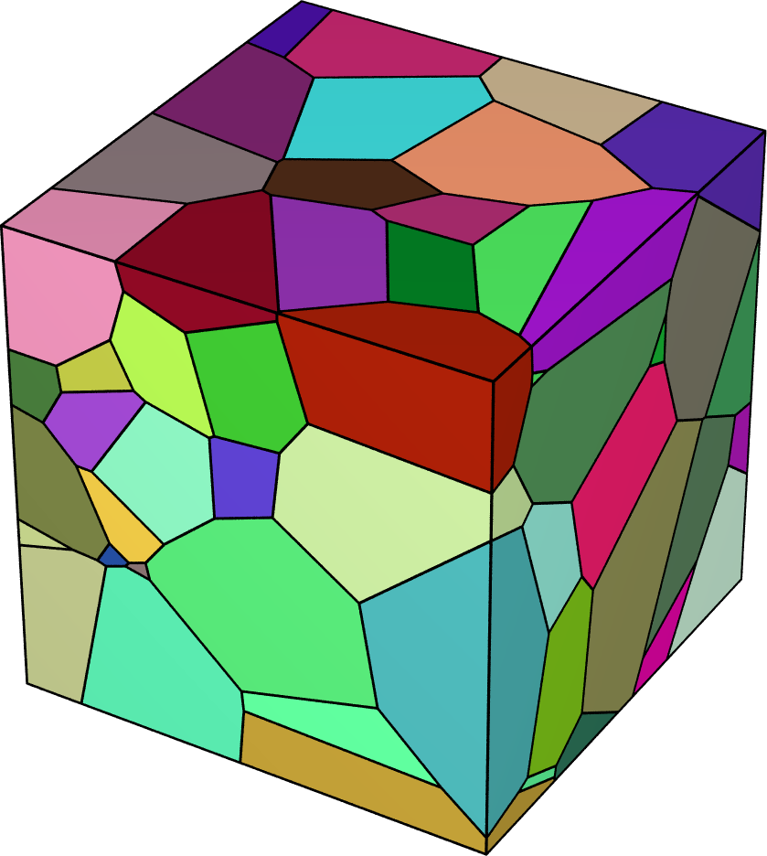
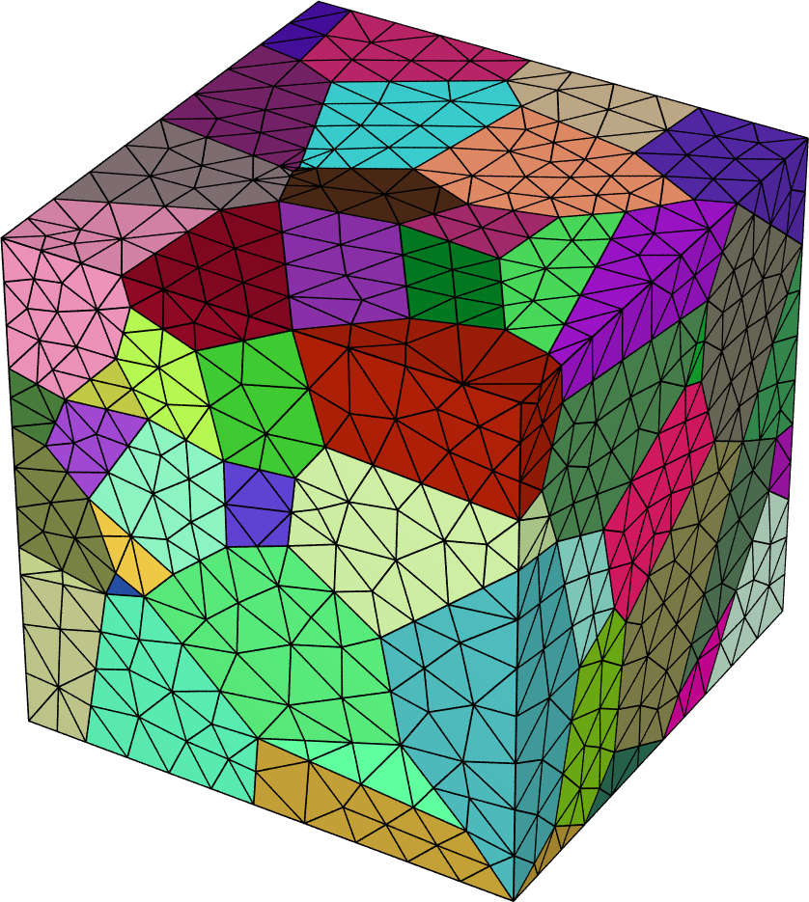
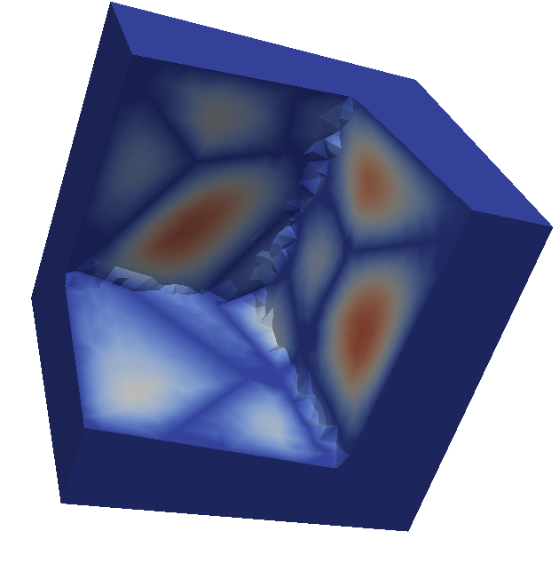
Motivation

Slide 4
FEM Pipeline
Geometry
Pre-processing
Mesh generation
Tensor operations
Assembly
Shape functions
Plasticity, dense solver QP
Direct solvers
Sparse Linear System
Iterative solvers
Post-processing
Vizualization of solution
Aggregate data (plotting)

Slide 5
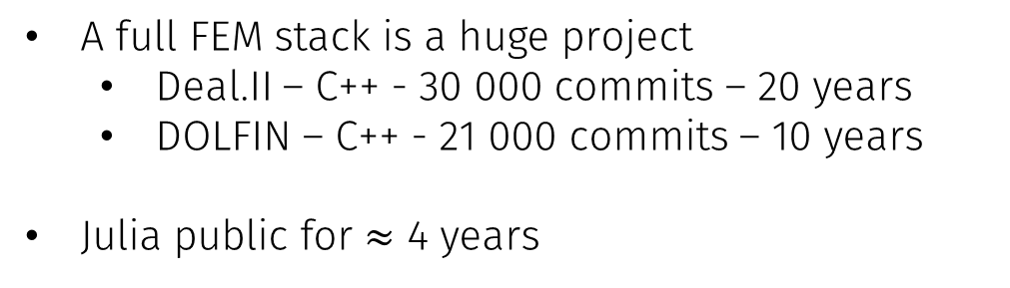
Full fledged Julia FEM package?
A full FEM stack is a huge project
Deal.II – C++ - 30 000 commits – 20 years
DOLFIN – C++ - 21 000 commits – 10 years
Julia public for $≈$ 4 years
JuliaFEM.jl - @ahojukka5 et al.
EllipticFEM.jl - @gerhardtulzer
DifferentialEquations.jl -@ChrisRackauckas

Slide 6
FEM Pipeline
Geometry
Pre-processing
Mesh generation
Tensor operations
Assembly
Shape functions
Plasticity, dense solver QP
Direct solvers
Sparse Linear System
Iterative solvers
Post-processing
Vizualization of solution
Aggregate data (plotting)

Slide 7
Geometry + Meshing
Many existing free non-Julia tools for geometry + meshing. GMSH, netgen, tetgen etc.
Works well, however, need to read the generated mesh files into Julia
Meshio.jl - @SimonDanisch
Currently, mostly computer graphics mesh formats
I recently added ABAQUS .inp format (in a PR)
Call to action!
Mesh readers

Slide 8
FEM Pipeline
Geometry
Pre-processing
Mesh generation
Tensor operations
Assembly
Shape functions
Plasticity, dense solver QP
Direct solvers
Sparse Linear System
Iterative solvers
Post-processing
Vizualization of solution
Aggregate data (plotting)

Slide 9
Tensor operations
Typically PDE’s are given as a collection of tensorial relations
Working with ”naked” Julia arrays as a representation of tensors possible
This is Julia! No fear of creating new types that maps more directly to our mathematical objects

Slide 10
Tensor operations
Einsum.jl - @ahwillia
TensorOperations.jl – @Jutho
using Einsum
A = zeros(5,6,7)
X = randn(5,2)
Y = randn(6,2)
Z = randn(7,2)
@einsum A[i,j,k] = X[i,r]*Y[j,r]*Z[k,r]
using TensorOperations
α=randn()
A=randn(5,5,5,5,5,5)
B=randn(5,5,5)
C=randn(5,5,5)
D=zeros(5,5,5)
@tensor begin
D[a,b,c] = A[a,e,f,c,f,g]*B[g,b,e] + α*C[c,a,b]
E[a,b,c] := A[a,e,f,c,f,g]*B[g,b,e] + α*C[c,a,b]
end

Slide 11
Tensor operations
ContMechTensors.jl - @KristofferC
Size of tensors known at compile time (1D, 2D, 3D), loop unrolling benefitial
Symmetric tensors are common
Stack allocation + infix notation → beautiful code
Maps directly to assembly instructions, no SIMD yet.
using ContMechTensors
A = rand(SymmetricTensor{2, 2})
B = rand(Tensor{4, 2})
x = rand(Vec{2})
A ⋅ x # dot product
A ⊗ A # open product
B ⊡ A # double contraction
det(A), inv(A), trace(A)
Notes:
Typically Colon is used for double contraction, why didn’t I use it?

Slide 12
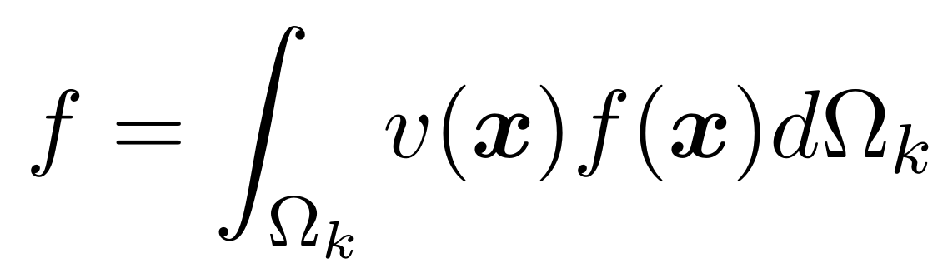
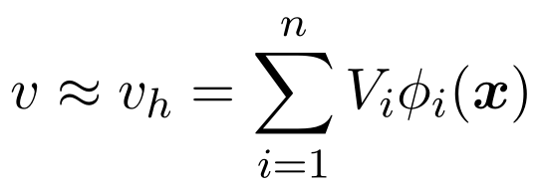
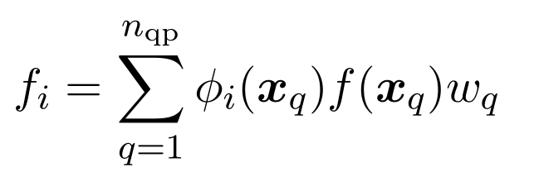
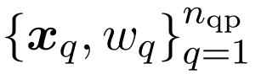
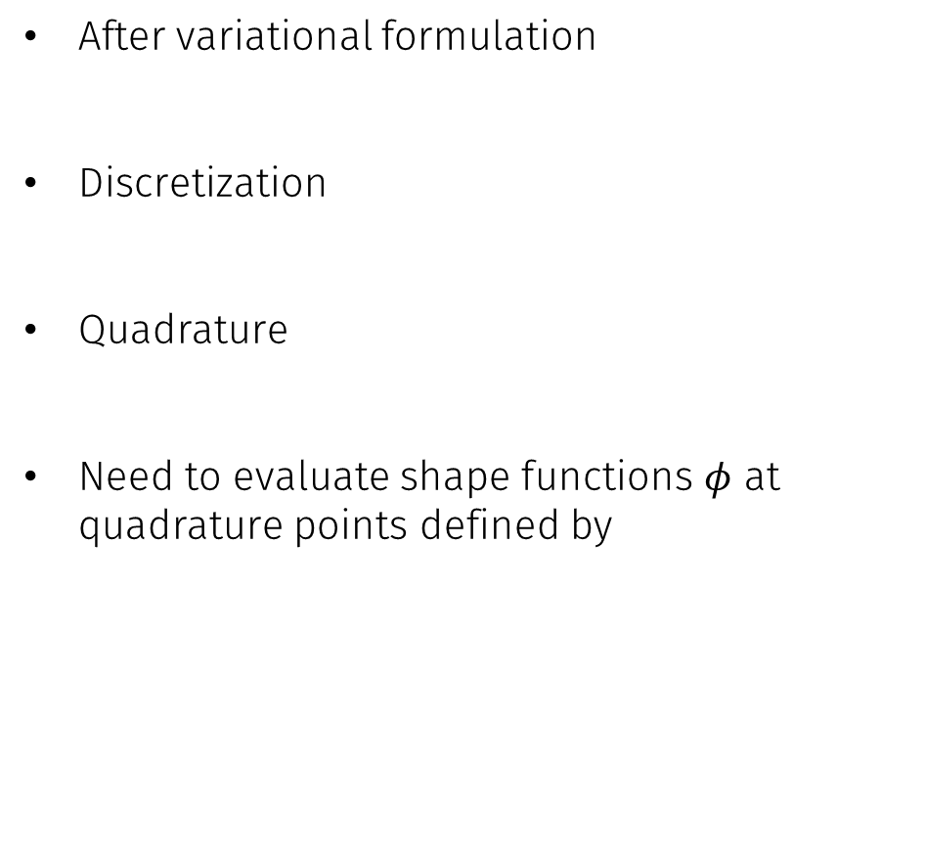
Shape functions
After variational formulation
Discretization
Quadrature
Need to evaluate shape functions $φ$ at quadrature points defined by
Notes:
Typically Colon is used for double contraction, why didn’t I use it?

Slide 13
Shape functions
JuAFEM.jl — @KristofferC, @fredrikekre
Quadrature
FastGaussQuadrature.jl for cubes, tables for tetrahedrons.
julia> quadrule = QuadratureRule(:legendre, Dim{2}, RefTetrahedron(), 1);
julia> points(quadrule)
1-element Array{ContMechTensors.Tensor{1,2,Float64,2},1}:
[0.333333,0.333333]
julia> weights(quadrule)
1-element Array{Float64,1}:
0.5
Notes:
Typically Colon is used for double contraction, why didn’t I use it?

Slide 14
Shape functions
JuAFEM.jl — @KristofferC, @fredrikekre
Basis
julia> const dim = 2;
julia> basis_order = 1;
julia> basis = Lagrange{dim, RefTetrahedron, basis_order}();
Notes:
Typically Colon is used for double contraction, why didn’t I use it?

Slide 15
Shape functions
JuAFEM.jl — @KristofferC, @fredrikekre
FEValues = quadrature + basis
julia> fe_values = FEValues(quadrule, basis);
julia> ele_coords = [Vec{2}((0.0, 0.0)),
Vec{2}((1.0, 0.0)),
Vec{2}((1.0, 1.0))]
julia> reinit!(fe_values, ele_coords)
julia> q_point = 1;
julia> node = 2;
julia> shape_value(fe_values, q_point, node)
0.33333333333333
julia> shape_gradient(fe_values, q_point, node)
2-element ContMechTensors.Tensor{1,2,Float64,2}:
1.0
-1.0
Notes:
Typically Colon is used for double contraction, why didn’t I use it?

Slide 16
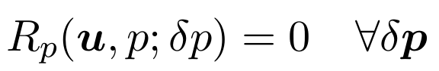
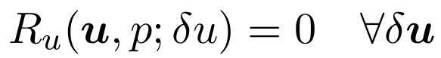
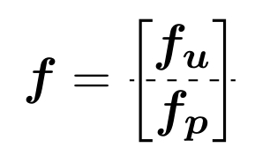
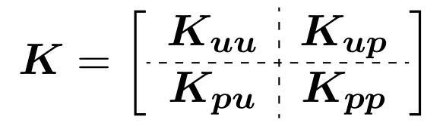
BlockArrays
Coupled/mixed problem leads to block like structures
Desireable to have a Julia array type that represents this

Slide 17
BlockArrays
BlockArrays.jl — @KristofferC, v0.5 only
Proposes an AbstractBlockArray interface, extension to AbstractArray
Two implementations of block arrays
PseudoBlockArray — whole matrix stored contiguously
BlockArray — each block stored contiguously

Slide 18
BlockArrays
julia> A = PseudoBlockArray(rand(3,3), [2,1], [2,1])
2×2-blocked 3×3 BlockArrays.PseudoBlockArray{Float64,2,Array{Float64,2}}:
0.587037 0.443899 │ 0.801079
0.132292 0.196876 │ 0.972342
──────────────────┼─────────
0.800054 0.251887 │ 0.78099
julia> A[Block(1, 2)]
2×1 Array{Float64,2}:
0.801079
0.972342
julia> A[Block(1, 2)] = [0, 0];
julia> A
2×2-blocked 3×3 BlockArrays.PseudoBlockArray{Float64,2,Array{Float64,2}}:
0.587037 0.443899 │ 0.0
0.132292 0.196876 │ 0.0
──────────────────┼────────
0.800054 0.251887 │ 0.78099
julia> nblocks(A)
(2,2)
julia> blocksize(A, 1, 2)
(2,1)
julia> full(A); # returns the ”normal” matrix

Slide 19
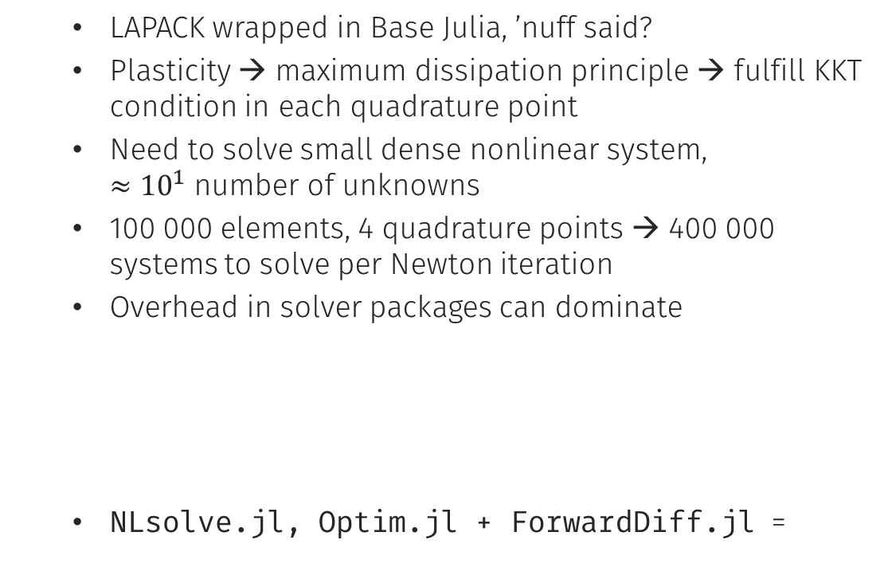
Dense solvers
LAPACK wrapped in Base Julia, ’nuff said?
Plasticity → maximum dissipation principle → fulfill KKT condition in each quadrature point
Need to solve small dense nonlinear system, $≈{10}^{1}$ number of unknowns
100 000 elements, 4 quadrature points → 400 000 systems to solve per Newton iteration
Overhead in solver packages can dominate
NLsolve.jl, Optim.jl + ForwardDiff.jl =
function solve(f, x0)
# allocate temporary arrays
for i in iter
do_step(f, x)
end
return solution
end
function solve(f, x0, cache=SolveCache(x0))
# unpack cache (Parameters.jl, @mauro3)
for i in iter
do_step(f, x)
end
return solution
end
Notes:
Julia of course has Lapack wrapped and it w
When do you need to solve dense systems in FEM?
One example is when you have plasticity, maximum dissipation principle -> KKT condition should be fulfilled in each quadrature point
Solve a nonlinear dense system in 10^1 variables
Many systems..
Overhead in solver packages.

Slide 20
FEM Pipeline
Geometry
Pre-processing
Mesh generation
Shape functions
Assembly
Tensor operations
Plasticity, dense solver QP
Direct solvers
Sparse Linear System
Iterative solvers
Post-processing
Vizualization of solution
Aggregate data (plotting)

Slide 21
Sparse Linear Solvers
Direct solvers
Cholmod + UMFPACK — Comes with Julia, ”\”
Pardiso.jl, Mumps.jl, Wrappers to C libraries
Iterative solvers
IterativeSolvers.jl - @jiahao et al.
KrylovMethods.jl - @lruthotto
Krylov.jl - @dpo
PyAMG.jl - @cortner — PyAMG wrapper with PyCall
See Lars Ruthotto: Iterative Methods for Sparse Linear Systems in Julia: A Quick Overview
PETSc.jl — Jared Crean — Talk on Friday

Slide 22
FEM Pipeline
Geometry
Pre-processing
Mesh generation
Shape functions
Assembly
Tensor operations
Plasticity, dense solver QP
Direct solvers
Sparse Linear System
Iterative solvers
Post-processing
Vizualization of solution
Aggregate data (plotting)

Slide 23
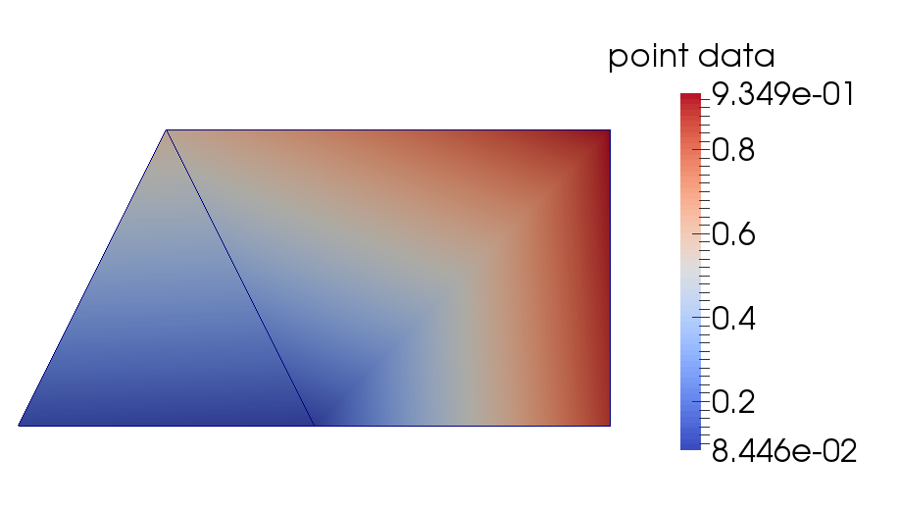
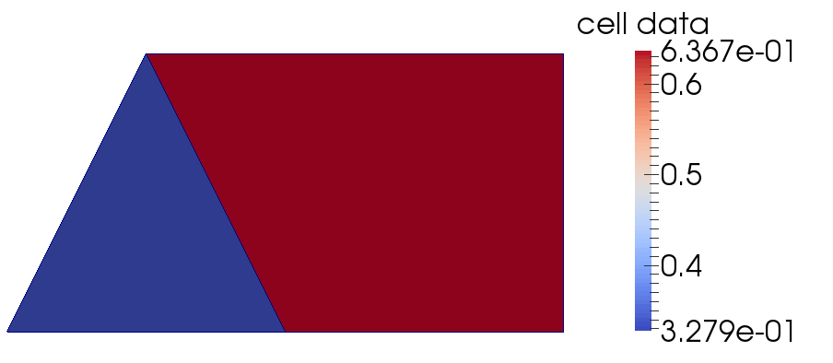
Vizualization of solutions
Dominating format: .VTK + Paraview/Visit
WriteVTK.jl - @jipolanco
using WriteVTK
points = [0.0 0.5 2.0 1.0 2.0;
0.0 1.0 0.0 0.0 1.0;
0.0 0.0 0.0 0.0 0.0]
cells = [MeshCell(VTKCellType.VTK_TRIANGLE, [1, 4, 2]),
MeshCell(VTKCellType.VTK_QUAD, [2, 4, 3, 5])]
vtkfile = vtk_grid("my_vtk_file", points, cells)
vtk_point_data(vtkfile, rand(5), "point data")
vtk_cell_data(vtkfile, rand(2), "cell data")
vtk_save(vtkfile)
Notes:
- If anyone has written an exporter for binary VTK you know it can be difficult, header has to be separately encoded

Slide 24
Aggregate data (plotting)
Plotting landcape in Julia used to be quite fragmented
Thanks to @tbreloff and Plots.jl this is no longer the case
Dataframes.jl + JLD.jl + Plots.jl (PGFPlots.jl backend for publications)
using JLD
using Dataframes
using Plots
pgfplots()
df = load("data.jld")[”analysis_data"]
data = extract_data(df)
p = plot(data)
PGFPlots.save("pgfplot.tex", p.o, include_preamble=false)

Slide 25
Kristoffer’s wishlist
Make working with stack allocated arrays easier
Array – powerful but big and heap allocated
Goto solution is tuples
Generated code explosions, type inference problems, immutability not always desired
See issue #11902
Facilitate not double paying lookup cost when mutating LinearSlow elements
K[i,j] += 1.0 → K[i,j] = K[i,j] + 1.0
K sparse → [i,j] expensive, double paying
See issue #15630 and
https://github.com/KristofferC/UpdateIndex.jl

Slide 26
Conclusions
Package landscape for FEM is developed well enough to do actual work
State of the art Automatic Differentiation makes local stiffness tangents a breeze to evaluate
Possible to use Julia for only a part of the FEM stack by calling into Julia from C++ FEM libraries

Slide 27


Thank you!
Slides
https://github.com/KristofferC/JuliaCon_FEM
Acknowledgements
Swedish Research Council
Julia Computing

